Slide 1
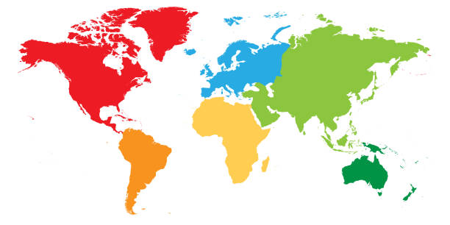
Pharma Quality Assurance Market - Global Forecast to 2034 (USD Mn)
By Solution Type
Global Market Size (2025) | 236.6 Mn
Global Market Size (2034) | 697.5 Mn
Global CAGR (2025-34) | 12.8%
North America Market Share (2025) | 39.3%
The US Market Size (2025) | 78.2 Mn
The US Market Growth Rate (2025-34) | 12.0%
Market Ecosystem and Regional Insights
Asia Pacific CAGR: 14.0%
North America Share: 39.3%
Contact Info: US: +1 732 369 9777, enquiry@dimensionmarketresearch.com

